Slide 1



The Carbon Farming Initiative and Agricultural Emissions
This presentation was prepared by the University of Melbourne for the Regional Landcare Facilitator training funded through the Australian Government’s Carbon Farming Initiative Communications Program

Slide 2
This presentation provides simplified examples of how offsets can be generated through on-farm actions
PART 10: CASE STUDIES
Notes:
Ensure that it is verbally made clear to the audience that the calculations in the case studies are simplified calculations only for the purpose of demonstration. To gain offsets for any of the abatement strategies used as examples here, there would need to exist an approved CFI methodology that details the quantification protocol and proves that the abatement strategy used would achieve the abatement claimed.

Slide 3
Case Studies – Dairy Farm
Sources | t CO₂e/farm
CH₄ – Enteric | 662.8
CH₄ - Effluent ponds | 60.9
N₂O - Effluent ponds | 1.0
N₂O - N Fertiliser | 38.9
N₂O - Indirect | 147.1
N₂O - Dung, Urine | 77.3
Net Farm Emissions | 988
Baseline
  Area = 100 ha
  Herd = 200 cows
    40 replacements/yr
  N fertiliser
    200 kg N/ha/yr as urea
Eckard 2011

Slide 4
Case Studies – Dairy Farm
Abatement strategy
  Dietary oils
      3.5% less CH₄ for every 1% extra oil
      = 20% less CH₄ for 90 days in summer
  Nitrification inhibitor spray
    Only for 90 days in winter
    = 40% less N₂O
      N fertiliser, leaching, effluent
  = 48 t CO₂e less @ $23*/t
  = $11/ha or $1,104/farm/yr
Sources | t CO₂e/farm
 | Before | After
CH₄ – Enteric | 662.8 | 634.0
CH₄ - Effluent ponds | 60.9 | 60.9
N₂O - Effluent | 1.0 | 1.0
N₂O - N Fertiliser | 38.9 | 35.8
N₂O - Indirect | 147.1 | 138.3
N₂O - Dung, Urine | 77.3 | 69.7
Net Farm Emissions | 988 | 940
* Actual price is likely to be lower than current carbon price
Eckard 2011

Slide 5
Case Studies - Dairy Cooperative
Baseline
  2,500 suppliers, 500,000 ha total
  Total N applied = 75,000 t N/yr
    Average N applied = 150 kg N/ha/yr
Abatement strategy
  Reduce total N to = 50,000 t N/yr
    Average N fertiliser = 100 kg N/ha/yr
  Reduce lime required 16,667 t lime/yr
  = 152,437 t CO₂e /yr
    @ $23*/t = $3,506,000/yr
* Actual price is likely to be lower than current carbon price
Eckard 2011

Slide 6
Case Studies – SE QLD Beef
Sources | t CO₂e/farm
 | Before | After
CH₄ – Enteric | 2,501 | 2,368
CH₄ – Manure | 1.39 | 1.32
N₂O - N Fertiliser | 0 | 0
N₂O – Indirect | 88 | 84
N₂O - Dung, Urine | 187 | 177
Net Farm Emissions | 2,778 | 2,630
Baseline
  454 cows
  180 1st calf heifers
  1,200 ha
Abatement strategy
  80 to 90% weaning
    10% less cows needed
    Include leakage discount
  = 148 t CO₂e @ $23*/t
  = $2.84/ha or $3,400/farm/yr
* Actual price is likely to be lower than current carbon price
Eckard 2011

Slide 7
Case study – Wheat
Sources | t CO₂e/farm
 | Before | After
CH₄ – Burning | 0.0 | 0.0
N₂O – Burning | 0.0 | 0.0
N₂O - Crop residues | 35.8 | 35.8
N₂O - Indirect leaching | 91.3 | 73.1
N₂O - Indirect ammonia | 24.4 | 19.5
N₂O - N Fertiliser | 73.0 | 58.4
N₂O - N₂ fixation | 0.0 | 0.0
Net Farm Emissions | 224.5 | 186.7
Baseline
  Area = 500 ha
  N fertiliser = 100 kg N/ha/yr
Abatement strategy
  Reduce N to 80 kg N/ha/yr
  = 38 t CO₂e @ $23*/t
  = $1.75/ha or $874/farm/yr
* Actual price is likely to be lower than current carbon price
Eckard 2011

Slide 8
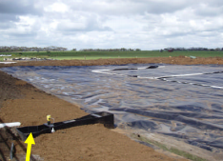
Case Study – Effluent Pond
Baseline
  300 cow dairy
  Open pond
    = 4.1 t CH₄/yr (85 t CO₂e)
  Covered pond
    = 6.3 t CH₄/yr (131 t CO₂e)
Data from Demo Dairy; Eckard 2011

Slide 9
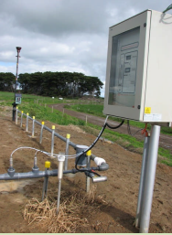
Case Study – Effluent Pond
CFI Offset
  Flaring
    Can only claim baseline prior to covering
      85 t CO₂e/yr
    @ $23*/t = $2,000/farm/yr
* Actual price is likely to be lower than current carbon price
Data from Demo Dairy; Eckard 2011

Slide 10
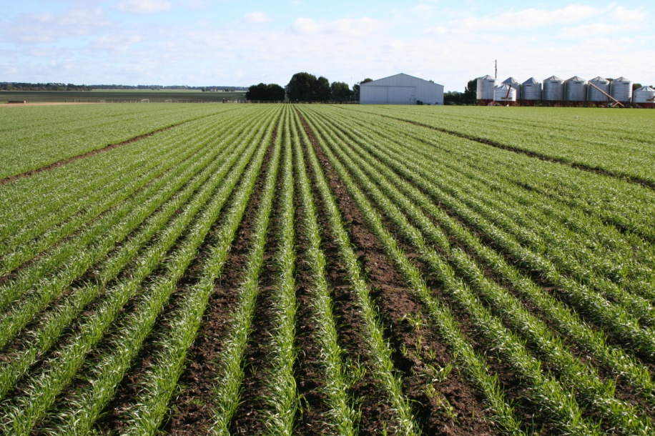
Case Study – Soil Carbon
  Western Victorian cropping system
    Good rainfall + good clay + min tillage (6-7 t DM/y)
    330 kg C/ha/yr = 0.3% in 10 years
    @ $15*/t CO₂e
    = $1.80/ha/yr
* Actual price is likely to be lower than Kyoto offset price

Slide 11
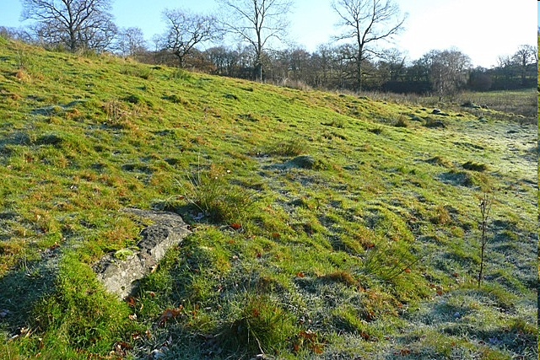
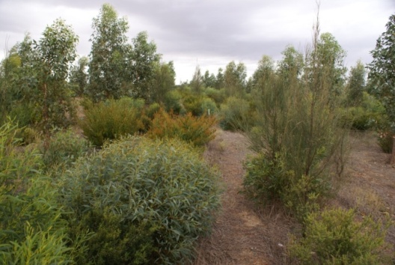
Case Study – Biodiverse planting
Baseline
  Pasture, regrowth suppressed
  5 ha planted
Abatement
  Carbon sequestration: 5 t C ha yr (18.3 t CO₂e)
    Average sequestration for 20 yrs
    Includes risk of reversal buffer
  @ $23*/t = $420/ha/yr or $2,110/5 ha/yr
* Actual price is likely to be lower than current carbon price

