Slide 1



The Carbon Farming Initiative and Agricultural Emissions
This presentation was prepared by the University of Melbourne for the Regional Landcare Facilitator training funded through the Australian Government’s Carbon Farming Initiative Communications Program

Slide 2
This presentation explains sinks of carbon and sources of methane and nitrous oxide emissions in agricultural systems
PART 4: THE MANAGEMENT OF AGRICULTURAL SOURCES AND SINKS

Slide 3
Introduction
Recent media focus on soil carbon
  Need more science at the forefront
Carbon Farming Initiative
  Crediting mechanism
    Land sector abatement and sinks
  Including soil carbon

Slide 4
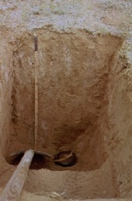
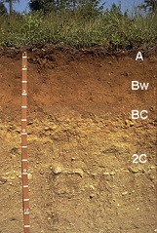
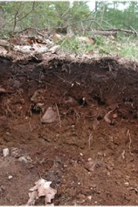
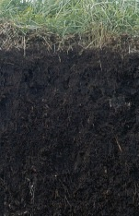
What is Soil Carbon?
Carbon forms in soil
  Inorganic forms
    carbonates, graphite, CO₂ (carbon dioxide), HCO₃ (hydrogen carbonate ion)
  Organic
    living, dead; labile, non-labile
In top 15 cm SOM typically ranges:
Organic soils:
up to 100%
Desert soils: < 1%
Agric soils: 1-5%
Forest soils: 1-10%

Slide 5
What is Soil Carbon?
Soil Organic Matter (SOM)
  The sum total of all organic carbon-containing substances in soils:
  Living biomass, decomposed residues and humus
Soil Organic Carbon (SOC)
  Carbon component of the SOM
Total Organic Carbon (TOC)
  SOC

Slide 6
What is Soil Carbon?
Crop residues
  Shoot and root residues less than 2 mm found in the soil and on the soil surface
  Energy to soil microbes
Particulate Organic Carbon (POC)
  Individual pieces of plant debris that are smaller than 2 mm but larger than 0.053 mm
  Slower decomposition than residues
  Provides energy and nutrients for microbes
Source: Jeff Baldock

Slide 7
What is Soil Carbon?
Humus
  Decomposed materials less than 0.053 mm that are dominated by molecules stuck to soil minerals
  All soil processes, source of N
Recalcitrant or resistant organic carbon (ROC)
  Biologically stable; typically in the form of charcoal.
Source: Jeff Baldock

Slide 8
Why is it important?
Roles of organic carbon (and associated elements) in defining soil productivity
Biological
roles
Physical
roles
Chemical
roles
- Biochemical energy
- Reservoir of nutrients
- Increased resilience
- Biodiversity
- Structural stability
- Water retention
- Thermal properties
- Erosion
- Cation exchange
- pH buffering
- Complexes cations
    1567 to 2700 Pg of C stored in soils worldwide
Source: Jeff Baldock

Slide 9
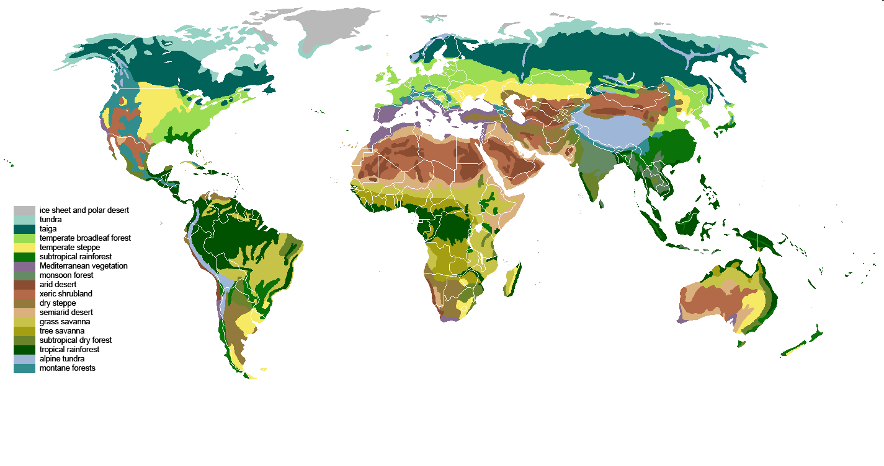
How does soil carbon compare to other sinks globally?
Global Carbon Stock (Pg C) Mill km²
Plants Soils Area
Tundra
2 115 5.6
Boreal forests
57 338 13.7
Temperate forests
139 153 10.4
Tropical forests
340 213 17.5
Tropical savannas
79 247 27.6
Temperate grass & shrublands
23 176 15.0
Deserts & Semi-deserts
10 159 27.7
Croplands
4 165 13.5
Total
654 1567
Saugier et al (2001)

Slide 10
What determines soil organic carbon content?
A big, slow-changing input : output equation
  Inputs: Plant residues & fire residues
  Outputs: Decomposition & mineralisation
Limited by
  Climate, soil type, management & nutrients
  Water is usually most limiting
    Good seasons = more soil C
    Drought = less soil C
Source: Jeff Baldock

Slide 11
How fractions differ between soils
Particulate organic carbon
Humus organic carbon
50
Resistant organic carbon
40
30
Soil organic carbon stock (Mg C/ha)
20
10
0
Soil 1
Soil 2
Soil 3
Soil 4
Soil 5
Soil 6
Soil 7
Understanding composition provides information on the vulnerability of soil organic carbon to change
Source: Jeff Baldock

Slide 12
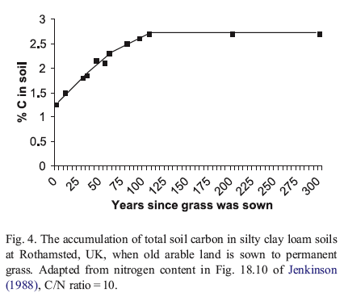
Can we quantify changes?
Longest experimental evidence
Soil-C increase often greatest soon after land-use or management change
Rate of change decreases after new equilibrium is reached.
BUT
1.2% to 2.7% in 110 years
= 0.013% /yr
Maximum of 0.4% in 25 years
Arable land → grass

