Slide 1



The Carbon Farming Initiative and Agricultural Emissions
This presentation was prepared by the University of Melbourne for the Regional Landcare Facilitator training funded through the Australian Government’s Carbon Farming Initiative Communications Program

Slide 2
This presentation provides background information on methane emissions, their global potential and explains methanogenesis
PART 5: METHANE FROM ANIMAL PRODUCTION
Notes:
This section takes 15 minutes

Slide 3
Methane from animal production
Content
  Introduction and background to methane emissions
  Global warming potential
  Methanogenesis in the rumen
  Methanogenesis in waste management systems
  Factors affecting methanogenesis

Slide 4
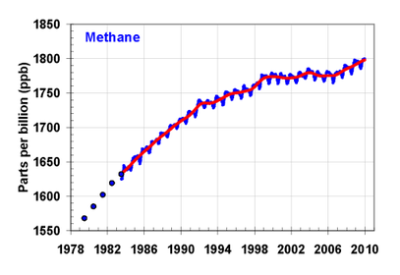
Methane from animal production
Global Trends in Atmospheric Methane
IPCC 2007

Slide 5
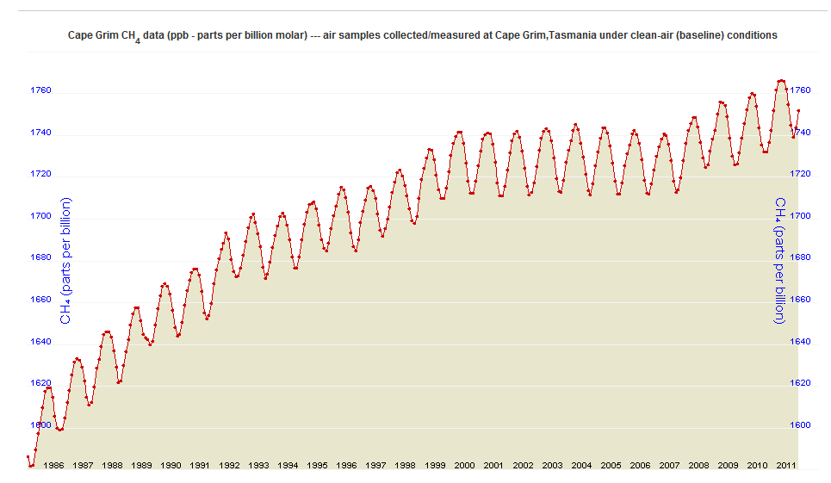
Methane from animal production
Australian Trends in Atmospheric Methane
CSIRO 2011

Slide 6
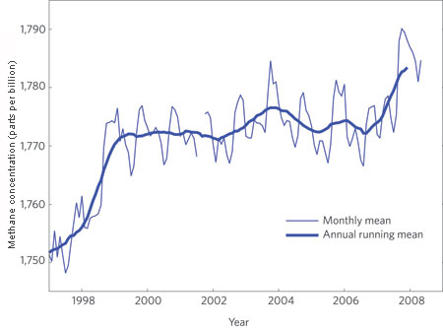
Methane from animal production
Unexpected rise in global methane concentrations from 2007
Mascarelli (2009)

Slide 7
Methane from animal production
Australian Methane Emissions
DCCEE 2011

Slide 8
Methane from animal production
Global warming potential
  Shorter lifetime in atmosphere
    8 to 12 years
  Concentrations
    Pre-industrial - 700 ppb
    Current - 1745 ppb
  High GWP
    72 x CO₂ on a 20 year time horizon
    21 x CO₂ on a 100 year time horizon (AR2 – DCCEE)
    25 x CO₂ on a 100 year time horizon (AR4)
IPCC 2007

Slide 9
Methane from animal production
Ruminants (cows, sheep)
  95% breathed and eructated
  5% from flatus
Non-Ruminants (pigs, poultry, horses)
  Mainly from flatus
  Horses, rabbits
    Extended caecum for microbial digestion
Effluent ponds
  Anaerobic ponds = more methane
Eckard 2011

Slide 10

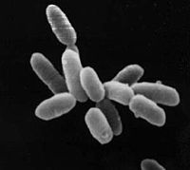
Methane from animal production
Microbes in the microbial digestion
  Bacteria, protozoa, fungi, archaea, and viruses
    40-60% bacteria, protozoa
    5-10% fungi
    3% Archaea (methanogens)
      Normal component of the rumen
      Many species yet to be identified!
      Eckard 2011

Slide 11
Methane from animal production
Methanogensis
  A form of anaerobic respiration
    4H₂ +CO₂→CH₄ +2H₂O
  Uses H₂ to reduce CO₂ to form CH₄
  Volatile Fatty Acid (VFA) production produces H₂
    BUT H₂ can also affect VFA production
  Interspecies hydrogen transfer
    From bacteria and protozoa to methanogens
      Klieve & Ouwerkerk 2007; Attwood & McSweeney 2009; McAllister & Newbold 2009

Slide 12
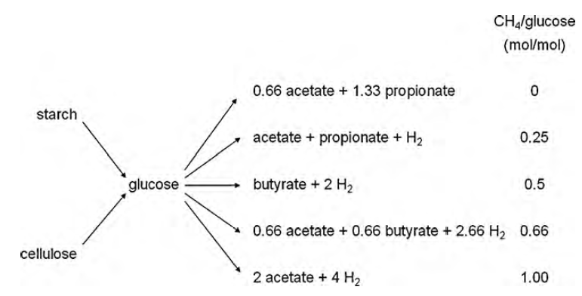
Methane from animal production
Volatile Fatty Acid production
  More propionate, less H₂, thus less CH₄
  More butyrate and acetate, more H₂, thus more CH₄
Jansen 2010

Slide 13
Methane from animal production
Waste management systems
  Piggery > Dairy > Poultry
DCCEE 2011

Slide 14
Methane from animal production
Waste management systems
  % of total on farm CH₄ from waste management
    7% of Dairy farm
    95% of Piggery
DCCEE 2011

Slide 15
Methane from animal production
Factors affecting methanogenesis
Less CH₄
  Faster rumen passage
  More O₂
  Less methanogens
  Less H₂
  Carbon
  Lower temperature
More CH₄
  Slower rumen rate
  Less O₂
  More methanogens
  More H₂
  Acid rumen pH
  Higher temperature
Eckard 2011

Slide 16
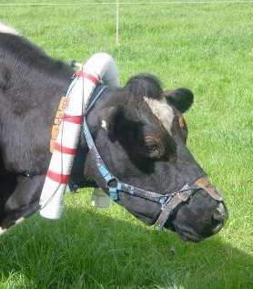
Methane from animal production
Largest inefficiency in animal production
  Methane energy content - 55.22 MJ/kg
  6 to 10% of GEI lost as CH₄
Animal Class | Methane (kg/year) | MJ CH₄ lost /hd/day | Effective annual grazing days lost | Potential km driven in 6-cylinder car
Mature ewe | 6 to 10 | 0.9 to 1.5 | 26 to 43 | 54 to 90
Beef steer | 50 to 90 | 7.6 to 13.6 | 33 to 60 | 450 to 800
Dairy cow | 90 to 146 | 13.6 to 22.1 | 25 to 40 | 800 to 1350
But: we cannot abate 100%
Eckard, Grainger & de Klein 2010

