Slide 1



The Carbon Farming Initiative and Agricultural Emissions
This presentation was prepared by the University of Melbourne for the Regional Landcare Facilitator training funded through the Australian Government’s Carbon Farming Initiative Communications Program

Slide 2
This presentation explains nitrous oxide emissions, their global potential and sources from agricultural systems
PART 6: NITROUS OXIDE FROM CROPPING AND ANIMAL PRODUCTION
Notes:
this section takes about 15 minutes

Slide 3
Nitrous oxide from cropping and animal production
Content
  Introduction and background to nitrous oxide emissions
  Global warming potential
  Sources from soils, fertilisers, legumes and animal waste
  Factors affecting nitrous oxide formation in soils

Slide 4
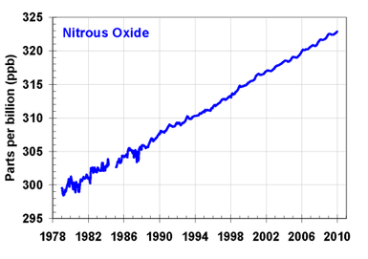
Nitrous oxide from cropping and animal production
Atmospheric Concentrations
  Pre-industrial - 270 ppb
  Current - 323 ppb
    0.25% per year
IPCC 2007

Slide 5
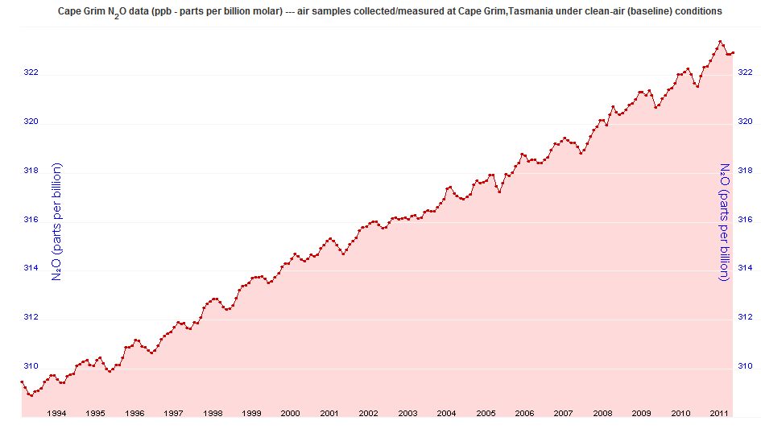
Nitrous oxide from cropping and animal production
Australian Atmospheric nitrous oxide
CSIRO 2011

Slide 6
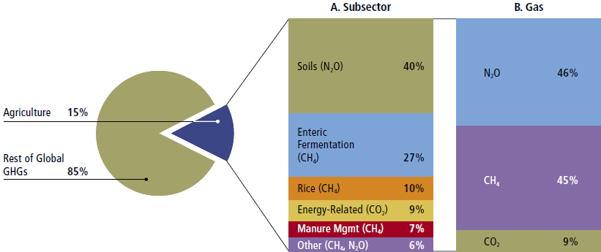
Nitrous oxide from cropping and animal production
Nitrous Oxide
  ∼10% of global greenhouse gas emissions
    ∼90% from agriculture
  2.5% of Australian national emissions
    76% from agriculture in Australia
Smith et al. 2007; de Klein & Eckard 2008

Slide 7
Nitrous oxide from cropping and animal production
Global Warming Potential
  N₂O = 298 x CO₂ (used in AR4)
    Note 310 x used in Australian inventory (and AR2)
  Long residence time in atmosphere
    Inert in the troposphere
      But absorbs radiation
    Stratosphere
      Cause ozone depletion
  Atmospheric concentration
    0.3 ppm (0.00003%)
IPCC 2007

Slide 8
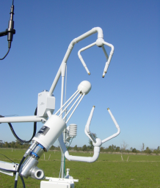
Nitrous oxide from cropping and animal production
Denitrification
  Warm, water-logged soils
  Excess N in soil
Nitrification
  Warm, aerobic soils
  Minor losses
Inefficient use of nitrogen
  >60% N lost from grazing
  >30% N lost from cropping
Eckard 2011

Slide 9
Nitrous oxide from cropping and animal production
  Sources of N₂O and % contribution
[
41%
26%
25%
18%
17%
6%
5%
4%
DCCEE 2011

Slide 10
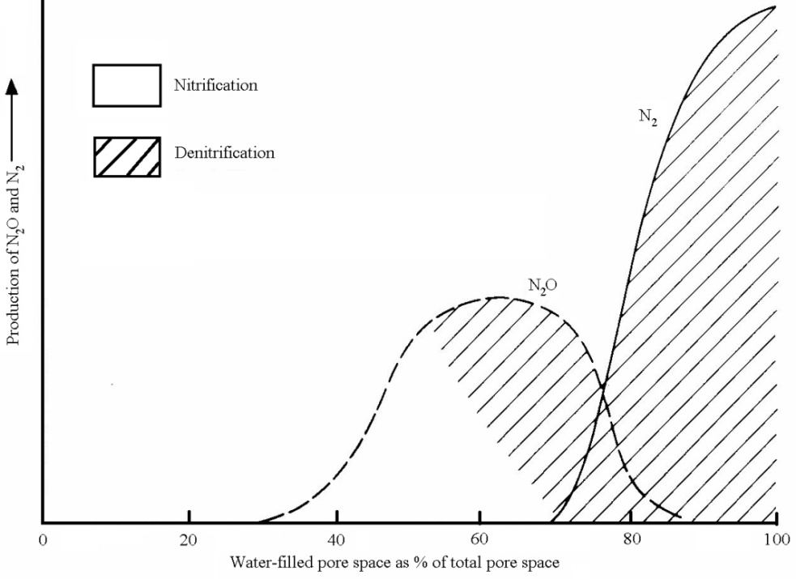
Nitrous oxide from cropping and animal production
Factors affecting nitrous oxide formation in soils
  N (NO₃)
  Soil Temperature
  Soluble C
  Soil pH
  Anaerobicity
Granli & Bøckman 1994

