Slide 1



The Carbon Farming Initiative and Agricultural Emissions
This presentation was prepared by the University of Melbourne for the Regional Landcare Facilitator training funded through the Australian Government’s Carbon Farming Initiative Communications Program

Slide 2
This presentation provides options to reduce methane and nitrous oxide emissions from agricultural systems
PART 8: OPTIONS FOR ABATEMENT – EMISSION REDUCTION

Slide 3
Options for abatement - Methane
Eckard 2008

Slide 4
Options for abatement - Methane
“Silver bullet”
Biological control
Vaccination
Rumen manipulation
Dietary
Supplements
Breeding
BMPs
Herd Management
Likely Impact
Immediate
Timeline
Longer Term
High
Confidence
Low
Eckard, Grainger & de Klein 2010

Slide 5
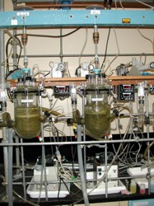
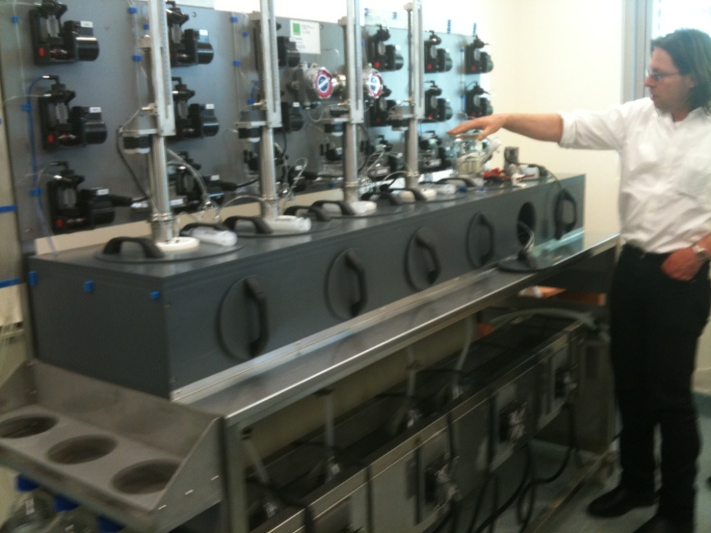
Options for abatement - Methane
Measurement – in vitro
  Test tubes
  Continuous Culture
AgResearch, New Zealand

Slide 6
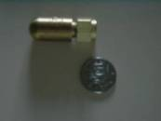
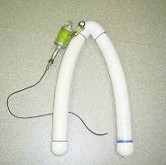
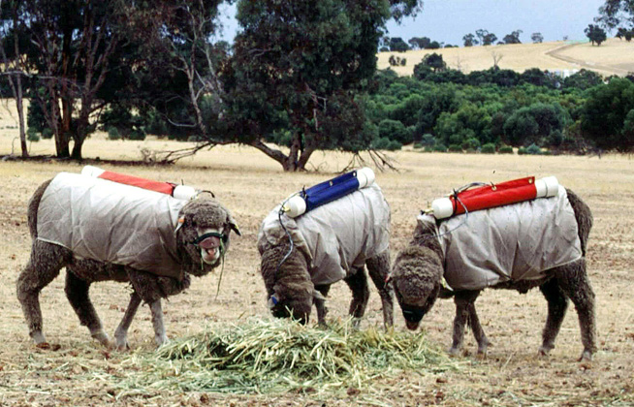
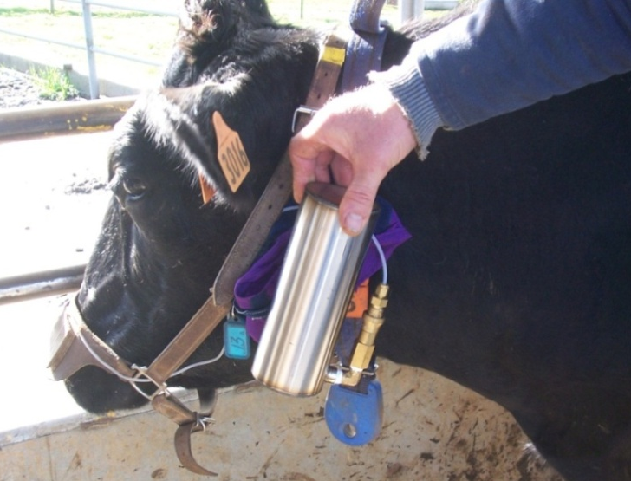
Options for abatement - Methane
Measurement
  SF₆ (sulphur hexafluoride)Tracer
    Individual animals in the field
Permeation tubes
Evacuated yolk/canister
Grainger, Eckard et al. 2007

Slide 7
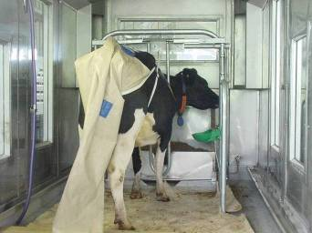
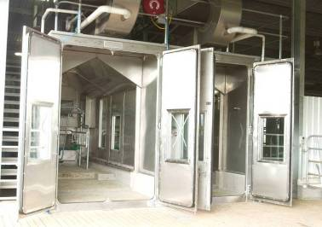
Options for abatement - Methane
Measurement
  Chambers/Calorimeters
    Individual Animals
Grainger, Eckard et al. 2007

Slide 8

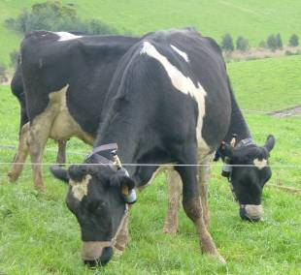


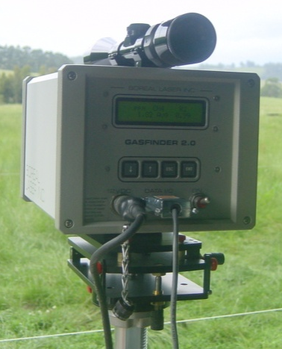
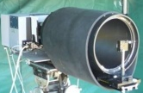
Options for abatement - Methane
Measurement
  Open Path laser or FTIR tracer
Reflector
Wind
Reflector
FTIR
Laser
FTIR
Griffiths et al. 2007; Phillips et al. 2009

Slide 9
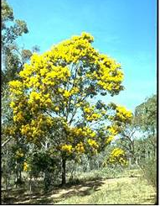
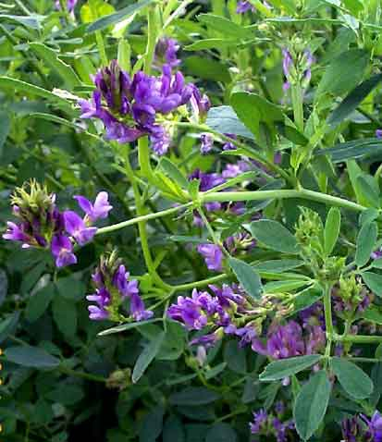

Options for abatement - Methane
Short term
  Feed quality
    Pasture improvement
    C3 pastures, legumes
  Dietary supplements
    Grain
    Tannins
    Oils
      1% fat = 3.5% decrease CH₄ /kg DMI
Eckard et al. 2010; Moate et al. 2010

Slide 10

Options for abatement - Methane
Short term
  Improving farm efficiency / animal numbers
    Extended lactation
    Earlier finishing of beef
    Reproduction, weaning percentages, fertility & health
  Alternative livestock systems
    Monogastrics & kangaroos?
      Pigs & chooks cannot covert grass into food
Eckard et al. 2010

Slide 11
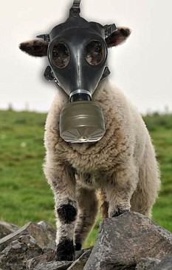
Options for abatement - Methane
Medium Term
  Animal Breeding
    Feed conversion efficiency
    Reduced methanogenesis
  Plant Breeding
    Improved energy to protein ratio
    Tannin, oils, sugars
Eckard, Grainger & de Klein 2010

Slide 12

Options for abatement - Methane
Longer-term
  Rumen manipulation/ biological control
    Vaccination
    Competitive or predatory microbes
    Acetogenesis (Kangaroo)
    Succinate (Tamar Wallaby)
Eckard, Grainger & de Klein 2010

Slide 13
Options for abatement – N₂O
Eckard 2008

Slide 14
Options for abatement – N₂O
“Silver bullet”
Biological control
Animal
Breeding
Soil Microbial
Manipulation
Nitrification
Inhibitors
Plant
Breeding
Secondary plant
compounds
BMPs
Diet
Herd Management
Likely Impact
Immediate
Timeline
Longer Term
High
Confidence
Low
De Klein & Eckard 2008

Slide 15
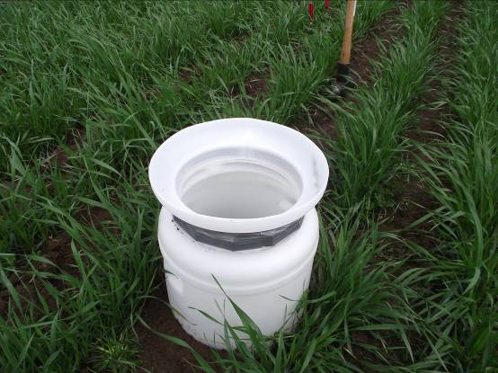
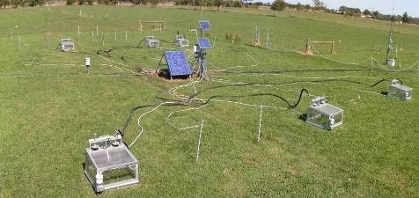
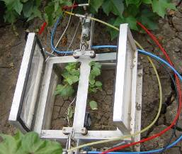
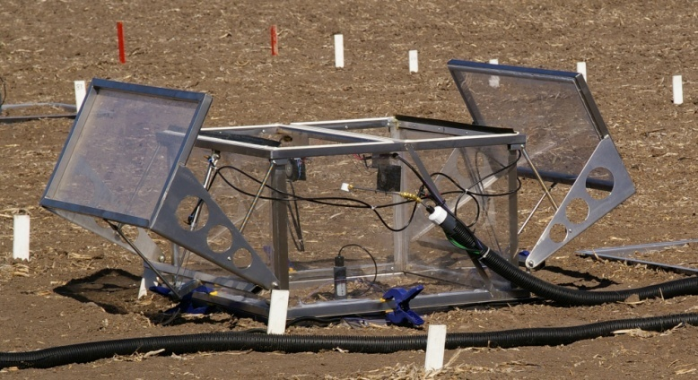
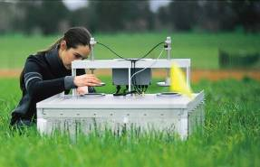
Options for abatement – N₂O
Measurement of N₂O
  Manual and automatic chambers

Slide 16
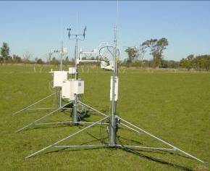
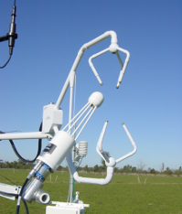
Options for abatement – N₂O
Measurement of N₂O
  Micrometeorological methods

Slide 17
Options for abatement – N₂O
Short term - Nitrogen Fertiliser Rate
    Match to plant demand
    Similar with effluent
Productivity
Environment
Eckard et al. 2006

Slide 18
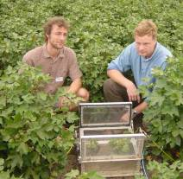
Options for abatement – N₂O
Short term - Nitrogen fertiliser rate
Grace et al. 2007

Slide 19
Options for abatement – N₂O
Short term - Choice of N Source
    In wet soils
      N₂O (nitrous oxide) from NO₃-N (nitrate) source
      Denitrification or leaching
    In dry soils
      N₂O (nitrous oxide) from NH₃ (ammonia)
      Volatilisation from urea
  N Placement
    Band, ridges
    Within paddock
Eckard et al. 2006

Slide 20
Options for abatement – N₂O
Short term - N Source and timing
Eckard et al. 2002

Slide 21




Options for abatement – N₂O
Short term - Fertiliser formulation
  Urease inhibitors
    Reduces NH₃ (ammonia) volatilisation
      eg. Agrotain®, Green UreaTM
  Nitrification inhibitors
    Reduces N₂O (nitrous oxide) and NO₃ (nitrate) leaching
    Temperature sensitive
      eg. DCD, Nitrapyrin, DMPP
ENTEC®
De Klein & Eckard 2008

Slide 22
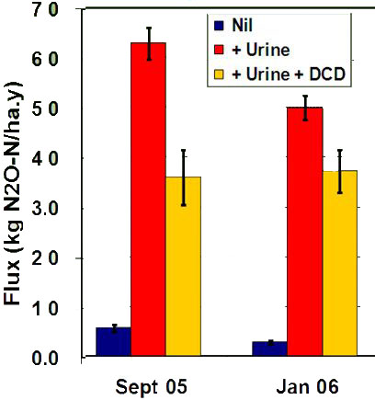
Options for abatement – N₂O
Short term - N formulation
  Nitrification Inhibitor sprays on pasture
    50% less N₂O
      for 50 days mid-spring
    25% less N₂O
      for 25 days in summer
Kelly et al;. 2008

Slide 23
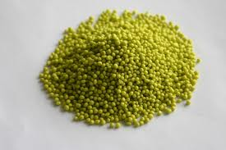
Options for abatement – N₂O
Short term - N formulation
  Controlled Release/Coated Fertilisers
    Polymer or oil-based coating
      Controlled pattern/rate of release
  Slow Release Fertilisers
    Reduced solubility
      Chemical
      Physical mixing
    Slower release of N
De Klein & Eckard 2008

Slide 24
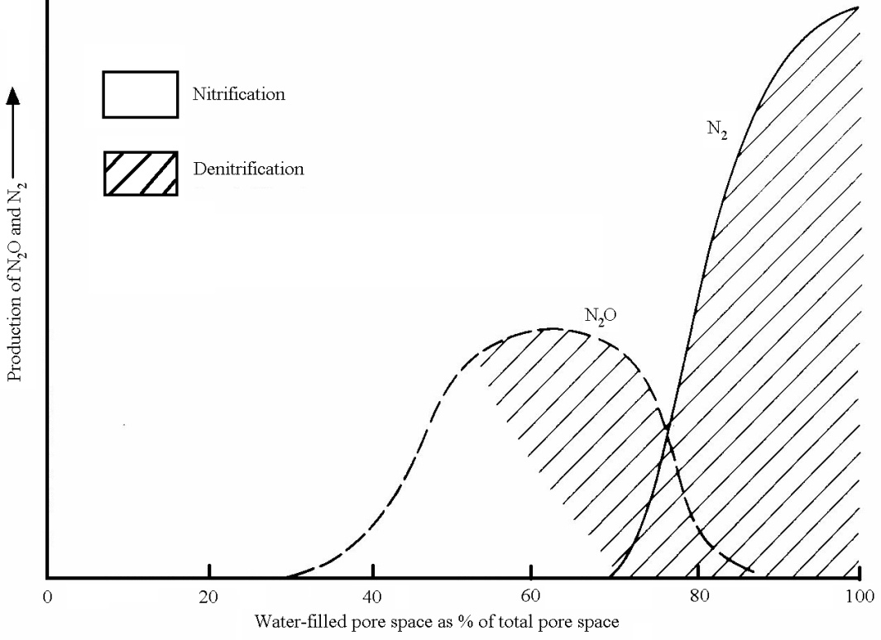
Options for abatement – N₂O
Short term – Soil Water / irrigation
Granli and Bøckman (1994)

Slide 25
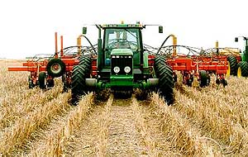
Options for abatement – N₂O
Short term - Soil Management
  Limited grazing on wet soils/ use of feedpads
  Soil structure
    Reduce waterlogging with N
    Reduce soil compaction with N
  Stubble management
    Retain stubble
    Conservation tillage and controlled traffic
    Build soil organic matter
  Reduce fallow
    Loss of unutilised N
    Cover crops
De Klein & Eckard 2008

Slide 26
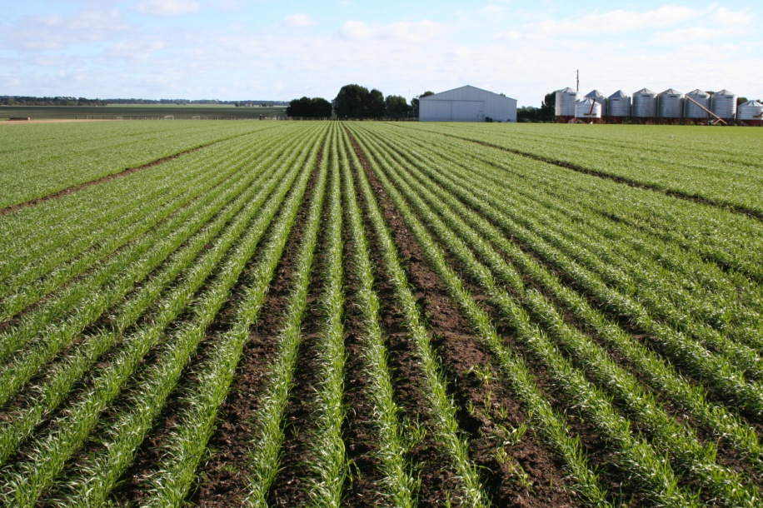
Options for abatement – N₂O
Medium term
  Plant breeding
    Tannin content
    Less N required
  Animal breeding
    More N efficient
Longer term
  Rumen manipulation
  Soil microbial manipulation
De Klein & Eckard 2008

Slide 27
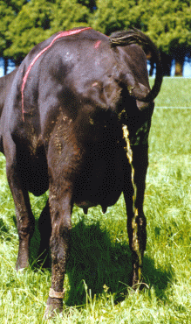
Options for abatement – N₂O
Urine Management
  Ruminants excrete 75 to 95% of N intake
Short Term
  Balancing ME:CP
  Feed tannins
  Animal numbers
    Reduce hot-spots
  Inhibitors
    Inhibitor spray
Longer Term
  Breeding
    Improve animal FCE
    Improve plant
      ME:CP
      tannins
Grainger et al. 2009; De Klein & Eckard 2008

