Slide 1



The Carbon Farming Initiative and Agricultural Emissions
This presentation was prepared by the University of Melbourne for the Regional Landcare Facilitator training funded through the Australian Government’s Carbon Farming Initiative Communications Program

Slide 2
This presentation provides an overview of how the Carbon Farming Initiative could work from individual farmer to industry level
PART 9: OPTIONS FOR ENGAGEMENT
Notes:
Likely to take 20 minutes or more

Slide 3
Options for Engagement
Content
  Methodology proponents
    Develop offset methods
  Aggregators
    Use methods to develop projects
  Project managers
    Aggregators or individuals
    Manage projects
      For groups of farmers
      Or for their own farm

Slide 4

Options for Engagement
  Methodology proponents – method development
  Follow procedures for CFI projects
    www.climatechange.gov.au/cfi
  Step 1
    Determine whether a new methodology is necessary
      Use existing methods, or
      Develop new methods
DCCEE 2011

Slide 5
Options for Engagement
  Methodology proponents – method development
  Future methods could cover:
    Reforestation, forest management and native forest protection
    Savanna fire management
    Manure management
    Methane from livestock
    Nitrous oxide from fertiliser
    Soil carbon and biochar
  More methods will become available over time

Slide 6
Options for Engagement
  Methodology proponents – method development
  Step 2
    Define the scope of the methodology
      Covered Abatement Activities
      Gasses covered
DCCEE 2011

Slide 7
Options for Engagement
  Methodology proponents – method development
  Step 3
    Define process for identifying a project baseline
      Historical baselines
      Projected baselines
      Comparison baselines
DCCEE 2011

Slide 8
Options for Engagement
  Methodology proponents – method development
  Step 4
    Define greenhouse gas assessment boundary
      What is in and what is out
      Considers leakage beyond the boundary
DCCEE 2011

Slide 9
Options for Engagement
  Methodology proponents – method development
  Step 5
    Define procedures for determining Project Area
      Farm, business unit, selected area
DCCEE 2011

Slide 10
Options for Engagement
  Methodology proponents – method development
  Step 6
    Define procedures for estimating abatement
      Estimate emissions and removals
      Formulas, algorithms, models
      Data required
      Accounting protocols
        Consistent with NGGI methods
        Based on peer reviewed science
        Top down and bottom up align
DCCEE 2011

Slide 11
Options for Engagement
  Methodology proponents – method development
  Step 7
    Outline processes for data collection, monitoring and reporting
      How data collected
      What data collected
      How the project will be monitored
      etc
DCCEE 2011

Slide 12
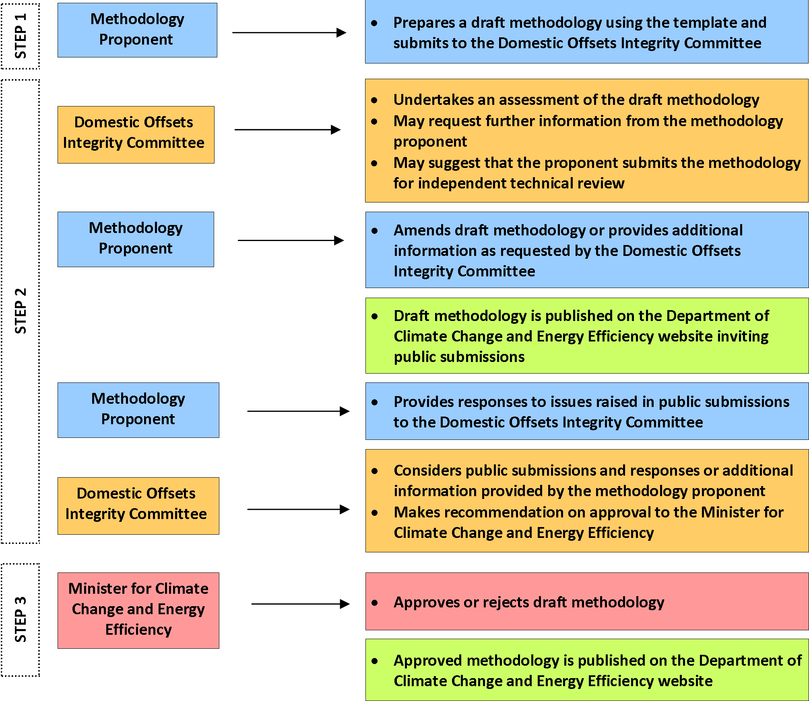
Options for Engagement
  Methodology proponents – approval process
DCCEE 2011

Slide 13
Options for Engagement
  Methodology proponents – approval process
DCCEE 2011

Slide 14
Options for Engagement
What are Aggregators?
  Develop and manage projects
    On behalf of farmers/land managers
  Projects developed from
    Approved methods
      Or multiple approved methods
    Can include new methods as proponents
  Can also act as brokers
    Link between buyers and projects
      Esp. the voluntary market
  Minimise transaction costs
    For farmers and for government
DCCEE 2011

Slide 15
Options for Engagement
Who can be Aggregators?
  Logical pre-farm aggregator
    Fertiliser company, feed supplier
  Logical post-farm aggregator
    Processor
    Cooperative
  Other aggregators
    Consultants, accountants
    Farmers, cropping groups etc
DCCEE 2011

Slide 16
Options for Engagement
Project managers (aggregators or individuals)
  Develop and submit a project to the Clean Energy Regulator for approval
    Can include one or several offset methodologies
    A new methodology they have developed
DCCEE 2011

Slide 17
Options for Engagement
Project managers (aggregators or individuals)
  Manage all measurement, reporting, verification, offset claims and financial transactions
  Provide supporting evidence
    As per the approved methodology(s)
      Complete, transparent, relevant
      Consistent, credible
      Bias and uncertainties reduced
DCCEE 2011

Slide 18
Options for Engagement
Project managers (aggregators or individuals)
  Ensure Integrity standards are met
    Additionality
    Permanence
    Leakage
    Accounting for all emissions sources and sinks
    Accounting for variability
    Measurable and verifiable
    Internationally consistent
    Based on peer-reviewed science
DCCEE 2011

Slide 19
Options for Engagement
Project managers (aggregators or individuals)
  Report to the Clean Energy Regulator
    No more than annually
    No greater than every 5 years
  Reporting is linked to crediting
DCCEE 2011

Slide 20
Options for Engagement
Options for farmers to engage
  Method Proponent
  Be an aggregator
    Larger enterprises with multiple sites/farms
  Engage an aggregator
  Manage their own project
DCCEE 2011

Slide 21
Options for Engagement
Options for farmers to engage
  4. Manage their own project (cont)
    If the method was simple to implement
      Minimal paperwork!
    Cost effective
      Returns justify effort
    Presents logical win-win
      Core business is farming
DCCEE 2011

